Slide 1
Global Advocacy Presentation

Slide 2
Make your own Advocacy Presentation!

Slide 3
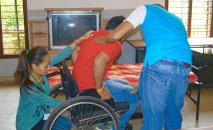
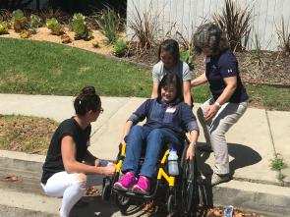
[Insert your context’s name] has a shortage of [Insert your profession] competent in appropriate wheelchair service
[Insert estimate number of wheelchair users in your context]
[Insert your context’s name] ratified the UN Convention on the Rights of Persons with Disability [Insert year]
Appropriately trained personnel is needed to meet this need*
Based on ISWP’s estimates⁺, [Insert your context’s name] requires at least [calculate 1 wheelchair provider per every 100 wheelchair users in your context]
*WHO. 2020. Assistive Technology Policy Brief
Reference to be added
Notes:
1% of the world’s population need a wheelchair
Access to an appropriate wheelchair is a human rights issue and a priority for sustainable development
Several factors are required to access, one of which is appropriately trained personnes
Make your own instructions:
Calculate 1% of your country’s population
CRPD in the country
Summarize your context’s wheelchair service provision situation (e.g. are there services, products, personnel, policies, personnel available)

Slide 4
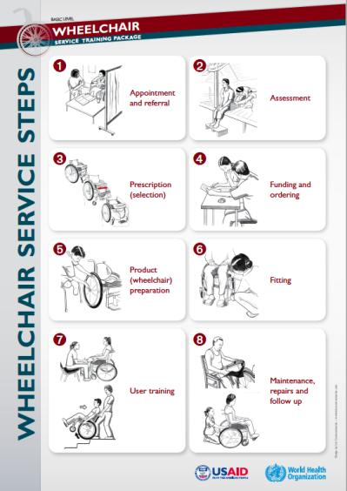
Global guidelines indicate that wheelchairs should be provided through an 8 step process by trained personnel*
*WHO. 2008. Guidelines on the Provision of Manual Wheelchairs in Less Resources Settings
Notes:
Impact of current WC service
Make your own instructions: Search for local research evidence on the impact of appropriate and inappropriate wheelchair services (and inappropriate? ex: local statistics on wheelchair user accidents; abandonment; wheelchair replacements/adjustments not due to growth, change in function or wear & tear, etc.

Slide 5
The current wheelchair content taught in our program may be insufficient to respond to the needs of the population
● Insert the information gathered using your program’s current
content assessed against the 8 steps (link)
AND/OR
● Insert the total and domain average scores from the ISWP Basic Knowledge
Test, use resource: Assess students’ current content (link)

Slide 6
Choose the slide based on your profession...
Notes:
Summarize your context’s wheelchair service provision situation (e.g. are there services, products, personnel, policies, personnel available)

Slide 7
Minimum Standards for the Education of Occupational Therapists (2016)
“The person - environment - occupation (PEO) relationship and its relationship to health, well-being and human rights.
Occupation Skills in: Analysis, adapting and grading occupation including Assistive technology scope and usage”
*WFOT. 2016. Minimum Standards for the Education of OT
Notes:
Make your on instructions:
Add accreditation standards, competency standards from national or provincial level, how does it add to the program or institution missions and values, including inclusion policies
Include pictures of locally available wheelchairs
If appropriate, include how it can bring revenue to the program (e.g continuing education course, micro-program)

Slide 8
Physical Therapist Professional Entry Level Education (2011)
Interventions and treatments include:
Therapeutic exercise which may include wheelchair propulsion programs and wheelchair training
prescription, application and, as appropriate, fabrication of devices and equipment (e.g. wheelchairs)

Slide 9
ISPO Education Standards for Prosthetics/Orthotics Education (2018)
“Graduates should demonstrate an understanding of foundational knowledge and skills in prescription recommendation, prosthetic/orthotic design, biomechanical principles, fitting, evaluation, adjustment, user-specific outcomes, and material selection for the following:...wheelchairs…”

Slide 10
The role of [insert profession] in wheelchair service in [insert your context’s name]
[Create a slide based on your professions context, for example:
Extract from the academic program accreditation process the requirements related to assistive technology education and make it specific to wheelchairs
Extract from the regulation of your profession, or competency standards, its role in assistive technology provision and make it specific to wheelchairs
Reflect - is there a risk that a component of practice may be lost to another profession?]

Slide 11
Other aspects to consider, if applicable:
Explore your program’s or institution’s mission and value and see how does integrating wheelchair service content add these
Include how it can bring revenue to the program (e.g continuing education course, micro-program)
Include qualitative testimonials or descriptives from internship preceptors / employers / mentors / wheelchair users on how new graduates are performing - or underperforming - in their expected role in wheelchair service

Slide 12
Let’s integrate wheelchair education in our program!
[Insert what you want the program to do, be as specific as possible]
What: [Insert the name of the course that you want to modify OR the new course that you want to create, Insert the additional number of hours that you are requesting, be prepared to recommend where content can be cut/reduced]
Where: [insert in what program(s) and/or academic period]
Who: [Insert the instructors, including the need for faculty to be trained first]
How: [Insert the resources that you may need and for which ones you need resources, e.g. wheelchairs, obstacles/space, mat table, measuring tapes, etc]

Slide 13
Global research indicates that current wheelchair content taught may be insufficient to minimum guidelines and evidence
Fung K et al. Wheelchair service provision education in academia. African Journal of Disability (Online). 2017;6:1-8.
Fung K et al. Integration of wheelchair service provision education: current situation, facilitators and barriers for academic rehabilitation programs worldwide. Disability and Rehabilitation: Assistive Technology. 2019 Apr 23.
McSweeney E, Gowran RJ. Wheelchair service provision education and training in low and lower middle income countries: a scoping review. Disability and Rehabilitation: Assistive Technology. 2019 Jan 2;14(1):33-45.

Slide 14
As a consequence, student’s current wheelchair service knowledge and skills may be insufficient to respond to the needs of the population
Best, K et al. "A description of manual wheelchair skills training curriculum in entry-to-practice occupational and physical therapy programs in Canada." Disability and Rehabilitation: Assistive Technology 10.5 (2015): 401-406.
Toro-Hernández M et al. Final Year Students’ Knowledge on Basic Manual Wheelchair Provision: The State of Occupational Therapy Programs in Colombia. Occupational therapy international. 2020 Apr 27;2020.
Toro-Hernández ML et al. Undergraduate physiotherapy students’ basic wheelchair provision knowledge: a pilot study in two universities in Colombia. Disability and Rehabilitation: Assistive Technology. 2019 May 16.

Slide 15
This research was made possible by the support of the American People through the United States Agency for International Development (USAID), International Society of Wheelchair Professionals (ISWP) and the University of Pittsburgh. University of Pittsburgh scientists are working with the U.S. Agency for International Development (USAID) under sub-awards to develop the International Society of Wheelchair Professionals, a global network to ensure a level of standardization, certification and oversight, to teach and professionalize wheelchair services, and to build affiliations to put better equipment in the right hands. Since 2002, USAID and other U.S. government agencies have granted more than $70 million to improve wheelchairs and wheelchair services worldwide. The sub-awards are: Agreement No. APC-GM-0068 and APC-GM-0107, Advancing Partners & Communities, a cooperative agreement funded through USAID under Agreement No. AIDOAA-A-12-00047; Grant Agreement No. SPANS-037, Special Programs to Address the Needs of Survivors, under Leader with Associates Agreement No. GPO-A-00-04-00021-00 between USAID and World Learning; and Subagreement No. FY19-A01-6024, under University Research LLC.

